Slide 1
Registration No- : T1187
Multi-Class Classification of Colorectal Cancer Tissue
TENCON 2022
Aaditya Kumar
3/4 B.Tech, ECE
IIIT Naya Raipur
Apoorwa Gupta
3/4 B.Tech, ECE
IIIT Naya Raipur
Sakshi Gupta
3/4 B.Tech, ECE
IIIT Naya Raipur
Shersth Gupta
PhD Scholar, ECE
IIIT Naya Raipur
Dr. Anurag Singh
Assistant Prof., ECE
IIIT Naya Raipur
Reg No. : T1187 Title : Multi-Class Classification of Colorectal Cancer Tissue

Slide 2
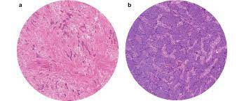
Introduction
TENCON 2022
Colorectal cancer (CRC) is a disease in which cells in the colon or rectum grow out of control.(Third most frequent type of cancer).
Its early detection is critical since it dictates treatment options and has a significant impact on survival time.
The basis of CRC diagnosis is the pathologic examination (colonoscopic biopsy or surgical excision).
Fig 1 Colorectal Cancer Representation
Reg No. : T1187 Title : Multi-Class Classification of Colorectal Cancer Tissue

Slide 3
Challenges
TENCON 2022
Manual examination of tissue samples has two major drawbacks-
First, it is time-consuming, especially for large image datasets.
Second, it is highly subjective and affected by variability, both inter and intra-observer.
Fig 1 Colorectal Cancer Representation
Reg No. : T1187 Title : Multi-Class Classification of Colorectal Cancer Tissue

Slide 4
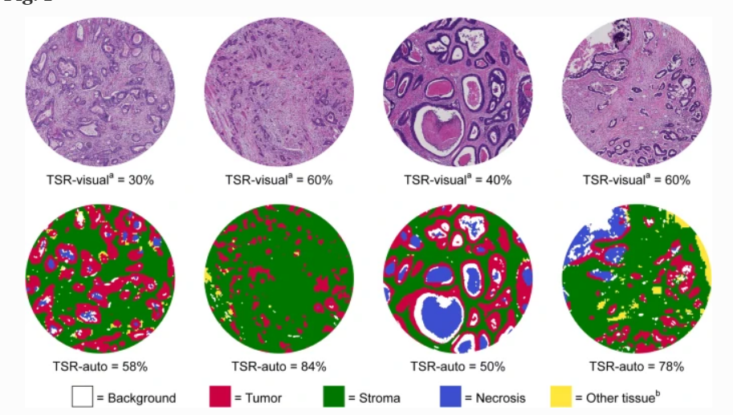
Motivation
TENCON 2022
As a result, there are increasing efforts to create computer-aided diagnostic tools in two main directions:
Automated segmentation- dividing diverse colorectal samples into homogeneous (i.e., comprising only one type of tissue) regions of interest.
Automatic classification- quantitative information taken from the image to classify homogeneous tissue sections into one of many classifications, either normal or malignant.
.
Segmentation
Reg No. : T1187 Title : Multi-Class Classification of Colorectal Cancer Tissue

Slide 5
Types of Tissues
Tumor
Complex
Stroma
Tumour epithelium
Complex stroma (containing single tumour cells and/or few immune cells)
Simple stroma (homogeneous composition, includes tumour stroma, extra-tumoural stroma and smooth muscle)
Lympho
Adipose
Debri
Mucosa
Immune cells (including immune-cell conglomerates and sub-mucosal lymphoid follicles)
Normal mucosal glands
Debris (including necrosis, hemorrhage, and mucus)
Normal mucosal glands

Slide 6
Limitations of Previous Studies
TENCON 2022
Only two categories of tissue (tumour and stroma) or 4 class classification, which makes these approaches unsuitable for more heterogeneous parts of the tumour.
For colorectal cancer, one of the most prevalent tumour types, there are in fact no published results on multiclass texture separation.
Limited Data Set.
Reg No. : T1187 Title : Multi-Class Classification of Colorectal Cancer Tissue

Slide 7
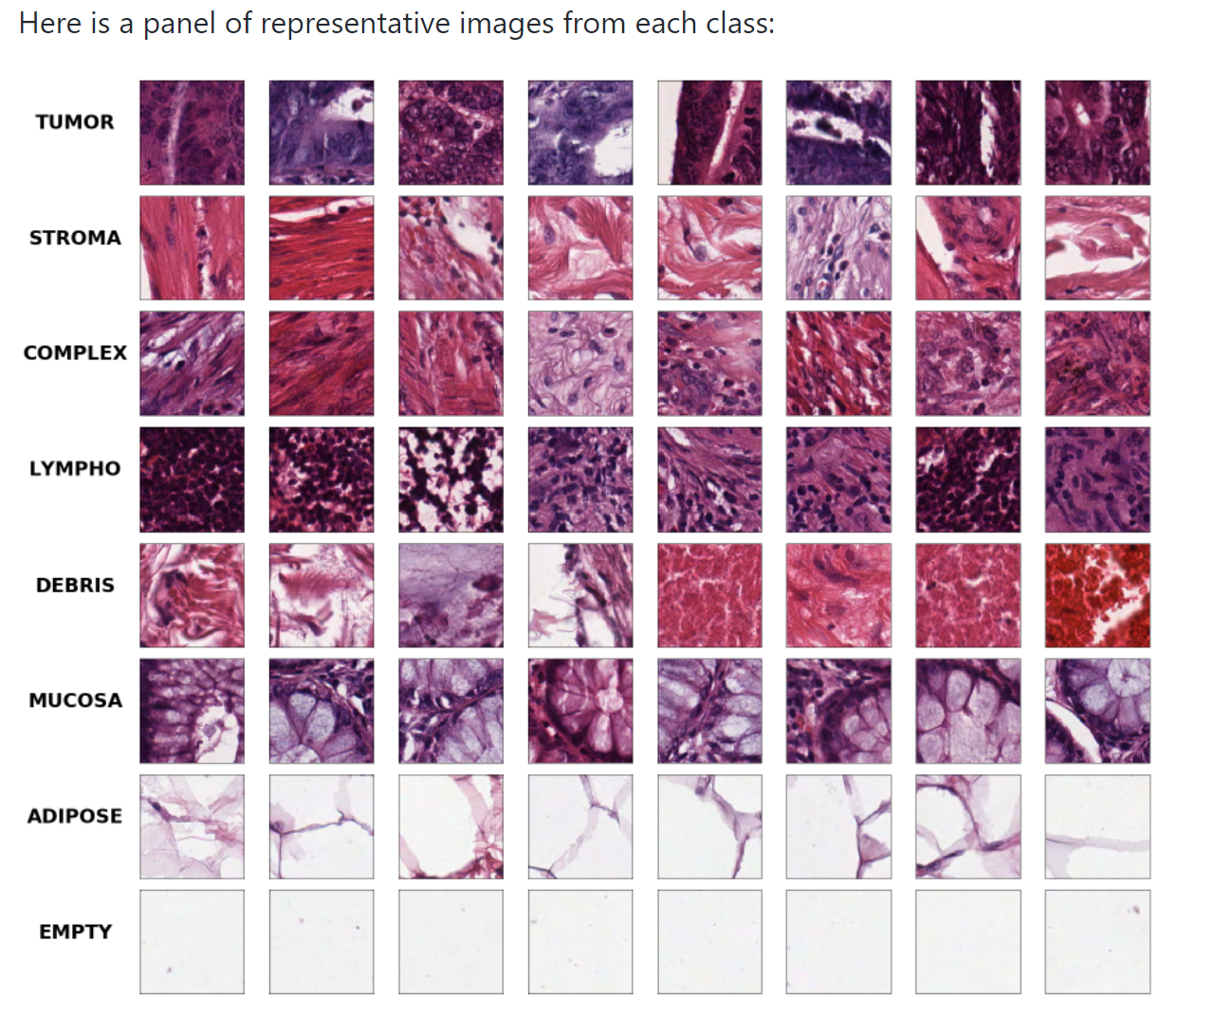
Data Set
TENCON 2022
The dataset contains 5000 images with 625 images for each class. All the images are 150x150px in RGB mode and divided into eight different tissue classes.
Reg No. : T1187 Title : Multi-Class Classification of Colorectal Cancer Tissue

Slide 8
Proposed Solution
TENCON 2022
Model Training
We will be first preprocessing the dataset. Data set was divided into
Training Set : 0.7
Validation set: 0.15
Testing set :0.15
Used 5 different CNN models for training: VGG 16, VGG19, RESNET50, RESNET 152V2, and INCEPTION V3
Reg No. : T1187 Title : Multi-Class Classification of Colorectal Cancer Tissue

Slide 9
Proposed Solution
TENCON 2022
Image transformation
To increase the performance of these pretrained models’ performance, image transformations were applied
Resize
Augmentation
Normalization
Reg No. : T1187 Title : Multi-Class Classification of Colorectal Cancer Tissue

Slide 10
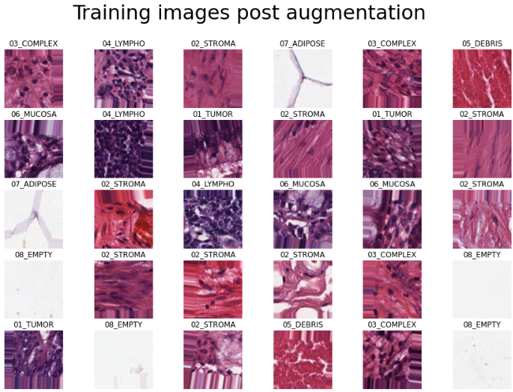
Proposed Solution
TENCON 2022
Visualize images post augmentation
Reg No. : T1187 Title : Multi-Class Classification of Colorectal Cancer Tissue

Slide 11
B. Finding the Superior Architecture and Parameters:
Model | Input Shape | No.of epochs | Optimizer
VGG16 | 244*244 | 50 | Adaptive moment estimation (Adam)
VGG19 | 244*244 | 50 | Adaptive moment estimation (Adam)
RESNET50 | 144*144 | 50 | Stochastic gradient descent (SGD)
InceptionV3 | 299*299 | 50 | Adaptive moment estimation (Adam)
ResNet152V2 | 224*224 | 50 | Stochastic gradient descent (SGD)

Slide 12
C. Model Testing
TENCON 2022
The last stage of our architectural parameters involved classifying the histological images through inception V3 by training the model to identify the types from different tissue classes.
Model | Accuracy on test images
VGG16 | 70.56%
VGG19 | 78.61%
RESNET50 | 81.24%
InceptionV3 | 89.82%
ResNet152V2 | 83.26%
Reg No. : T1187 Title : Multi-Class Classification of Colorectal Cancer Tissue

Slide 13
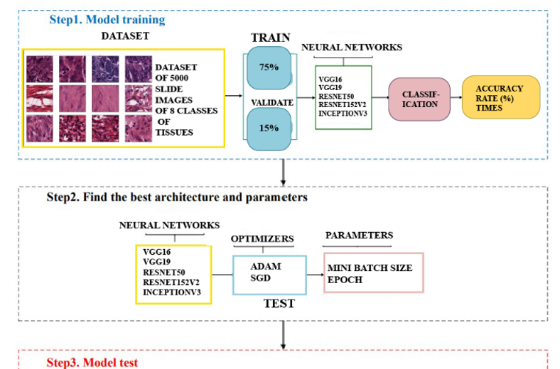
TENCON 2022
Reg No. : T1187 Title : Multi-Class Classification of Colorectal Cancer Tissue

Slide 14
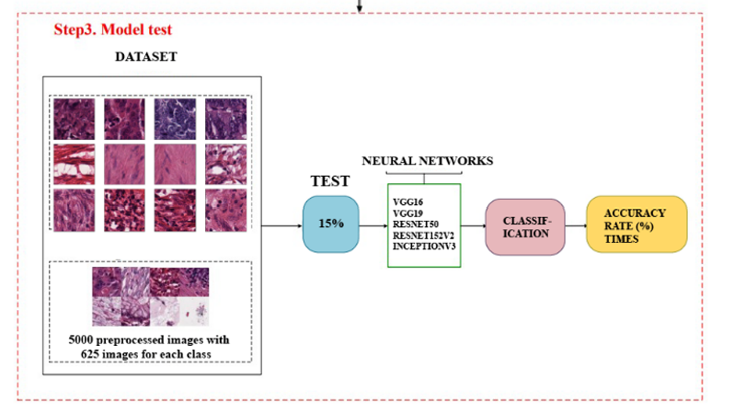
Representation through diagram(Contd.)
TENCON 2022
Reg No. : T1187 Title : Multi-Class Classification of Colorectal Cancer Tissue

Slide 15
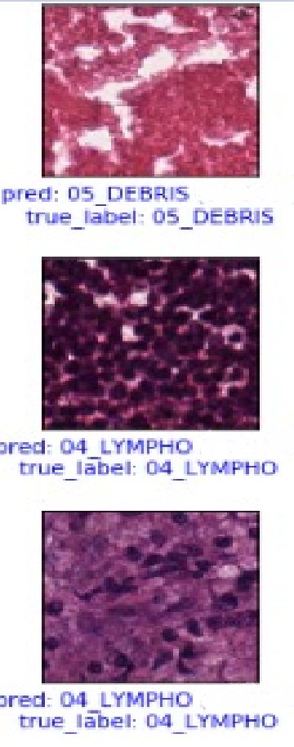
Prediction accuracy for each tissue type by Inception_v3 model
TENCON 2022
TUMOR -- 89.77%
STROMA -- 82.93%
COMPLEX -- 83.16%
LYMPHO -- 84.04%
DEBRIS -- 89.00%
MUCOSA -- 93.75%
ADIPOSE -- 94.85%
EMPTY -- 100.00%
Result
Reg No. : T1187 Title : Multi-Class Classification of Colorectal Cancer Tissue

Slide 16
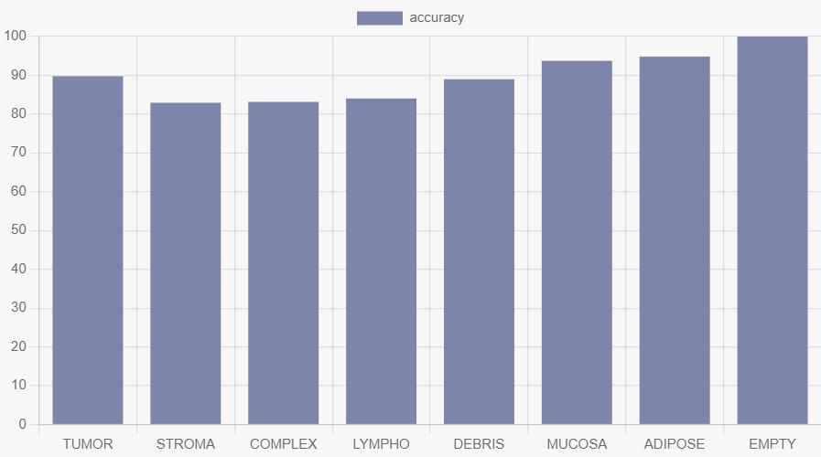
Prediction accuracy for each tissue type by Inception_v3 model
Histogram for various classes and their accuracies
TENCON 2022
Histogram for various classes and their accuracies
Reg No. : T1187 Title : Multi-Class Classification of Colorectal Cancer Tissue

Slide 17
Comparing Accuracies of various models
Model | Accuracy on test images
VGG16 | 70.56%
VGG19 | 78.61%
RESNET50 | 81.24%
InceptionV3 | 89.82%
ResNet152V2 | 83.26%

Slide 18
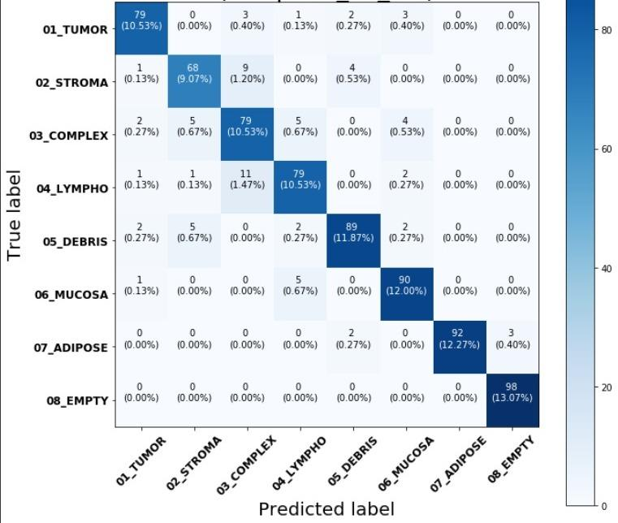
Final Confusion Matrix Inception v3
TENCON 2022
Confusion Matrix
Reg No. : T1187 Title : Multi-Class Classification of Colorectal Cancer Tissue

Slide 19
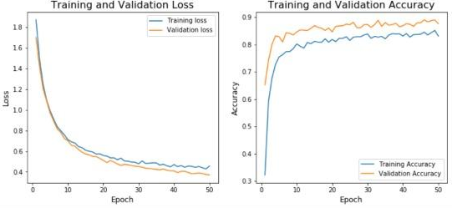

Slide 20
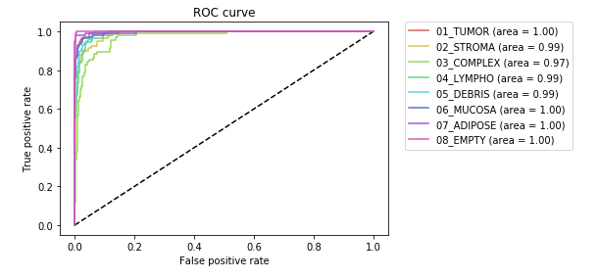

Slide 21
Conclusion
TENCON 2022
In this research work we investigated the use of deep learning, and more specifically Convolutional Neural Networks, for the automated classification of colorectal histology samples into eight main classes of interest: Tumor, Stroma, Complex, Lympho, Debris, Mucosa, Adipose, and Empty.
We compared the ability of the five most commonly-used deep learning network models to accurately distinguish colorectal cancer tissues. InceptionV3 achieved 89.8% accuracy.
Reg No. : T1187 Title : Multi-Class Classification of Colorectal Cancer Tissue

Slide 22
References
TENCON 2022
Jakob Nikolas Kather, Cleo-AronWeis, Francesco Bianconi, Susanne M. Melchers\, Lothar R. Schad, TimoGaiser, Alexander Marx & FrankGerritZöllneR., "Multi-class texture analysis in colorectal cancer histology," 2016 Scientific Reports | 6:27988 | DOI: 10.1038/srep27988.
Min-Jen Tsai and Yu-Han Tao,"Deep Learning Techniques for the Classification of Colorectal Cancer Tissue" in Electronics 2021, 10, 1662.
Junaid Malik, Serkan Kiranyaz, Suchitra Kunhoth, Turker Ince, Somaya Al-Maadeed, Ridha Hamila, Moncef Gabbouj, "Colorectal cancer diagnosis from histology images: A comparative study" in Turker Ince (turker.ince@ieu.edu.tr) is with Izmir University of Economics.
Reg No. : T1187 Title : Multi-Class Classification of Colorectal Cancer Tissue

Slide 23
References
TENCON 2022
Francesco Ponzio, Enrico Macii, Elisa Ficarra and Santa Di Cataldo “Colorectal Cancer Classification using Deep Convolutional Networks" Department of Control and Computer Engineering, Politecnico di Torino, Corso Duca degli Abruzzi 24, 10129 Torino, Italy.
4.
Reg No. : T1187 Title : Multi-Class Classification of Colorectal Cancer Tissue

Slide 24
Thanks
Please keep this slide for attribution

